Slide 1
Preparation of semi-conducting polymers dispersed in organic media
Dr. Abdulkarim CHARBA

Slide 2
Introduction: semi-conducting polymers
Conjugated structure
Doping procedure

Slide 3
Exemples of conjugated polymers

Slide 4
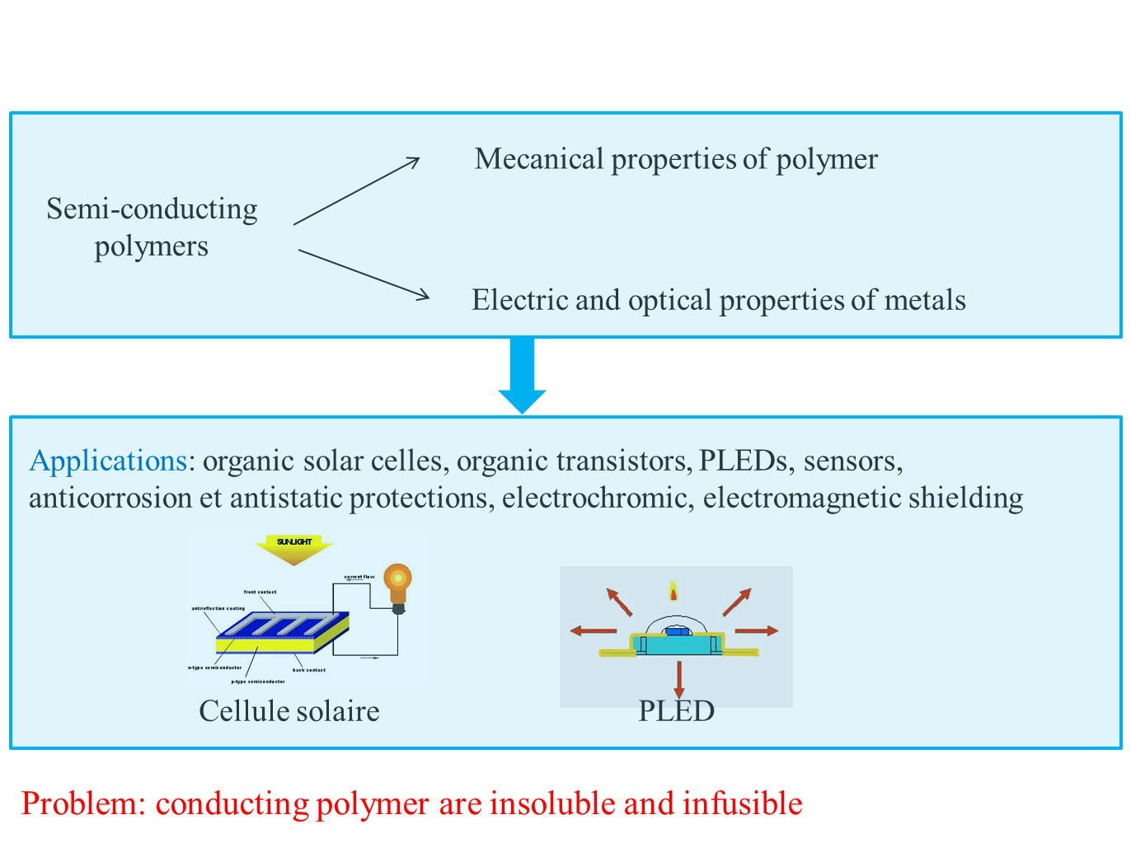

Slide 5
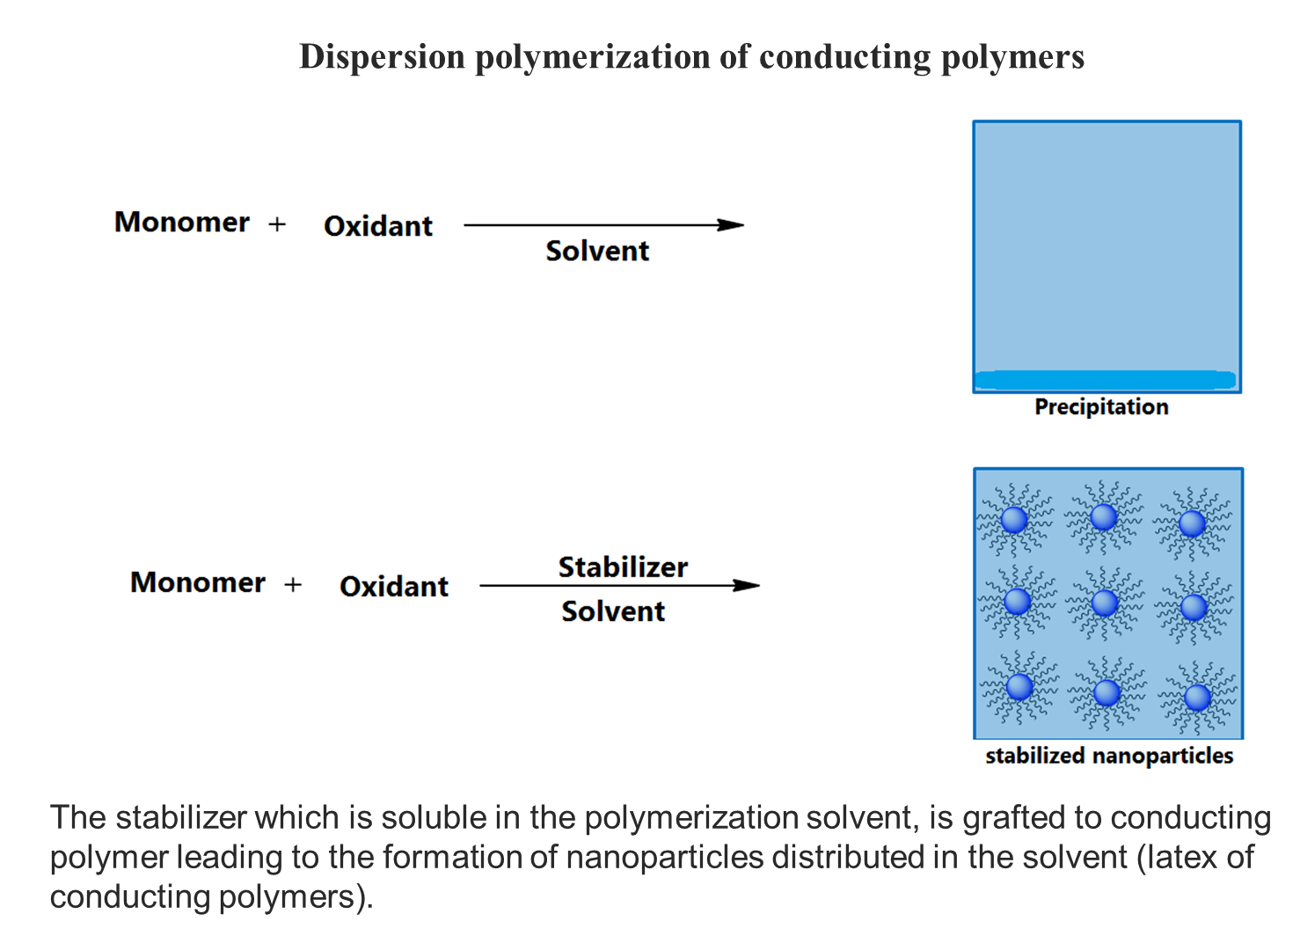

Slide 6
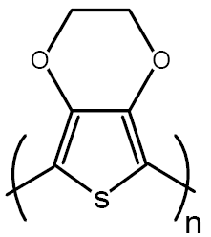
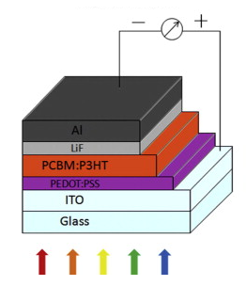

Slide 7
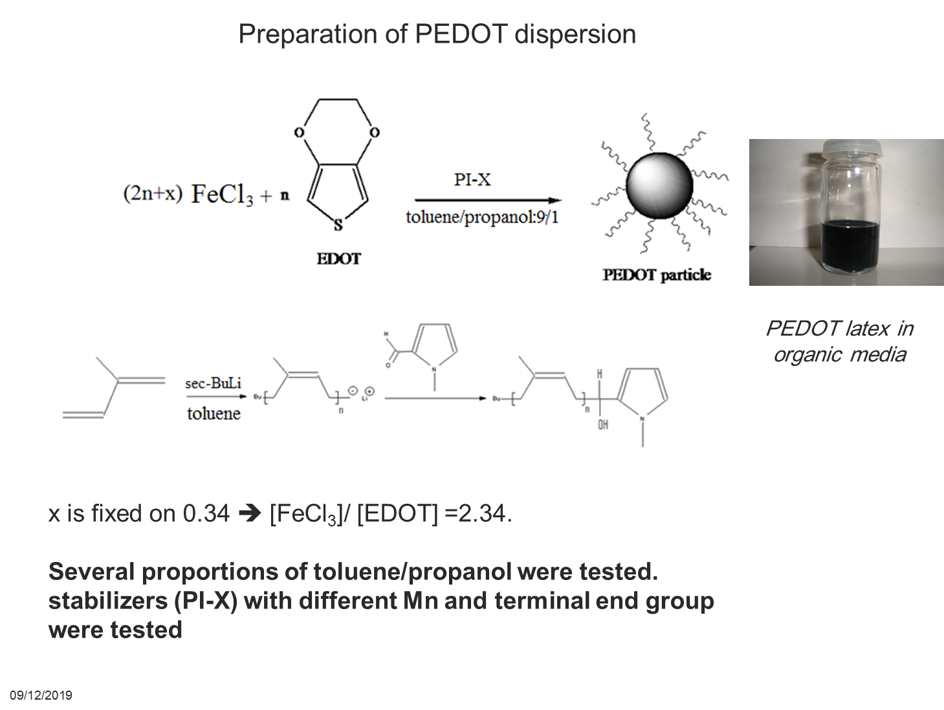
PI-X: functionalized polyisoprene
Organic solvent: easy to evaporate and safe for electronic circuits

Slide 8
Dispersion polymerization of EDOT in the presence of PI-Py as a stabilizer
Effect of the PI-Py concentration
run | Stabilizer | Mn(stabilier) (g/mole) | Wt% of PI-Py introduced ^{b} | T(°C) | solvent | σ (S/cm) | Particles diameter (nm) ^{c}
7 | PI-Py | 62000 | 40% | 50 | Toluene/propanol :9/1 | 0.003 | 25-50
2 | PI-Py | 62000 | 20% | 50 | Toluene/propanol :9/1 | 0.016 | 40-80
8 | PI-Py | 62000 | 8% | 50 | Toluene/propanol :9/1 | 0.1 | 50-80
b)Versus the monomer c)Calculated by TEM
Spherical particles of 50-80 nm diameter
PI-Py (62000g/mol ) (8 wt %)
Spherical particles of 40-80 nm diameter
PI-Py (62000g/mol ) (20wt %)
Spherical particles of 25-50 nm diameter
PI-Py (62000g/mol ) (40wt %)
TEM images of PEDOT particles prepared in the presence of PI-Py

Slide 9
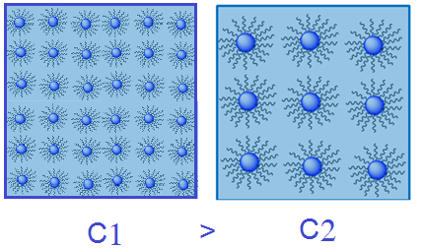
Dispersion polymerization of EDOT in the presence of PI-Py as a stabilizer
Effect of the PI-Py concentration
run | Stabilizer | Mn(stabilier) (g/mole) | Wt% of PI-Py introduced ^{b} | T(°C) | solvent | σ (S/cm) | Particles diameter (nm) ^{c}
7 | PI-Py | 62000 | 40% | 50 | Toluene/propanol :9/1 | 0.003 | 25-50
2 | PI-Py | 62000 | 20% | 50 | Toluene/propanol :9/1 | 0.016 | 40-80
8 | PI-Py | 62000 | 8% | 50 | Toluene/propanol :9/1 | 0.1 | 50-80
b)Versus the monomer c)Calculated by TEM
Increasing the concentration ➔ more stable particles at the beginning of the reaction
➔ Smaller particles at the end of the reaction.

Slide 10
Dispersion polymerization of EDOT in the presence of PI-Py as a stabilizer
Effect of the molecular weight of PI-Py
Mn (ω-Py-PI) (g/mole) | wt% of ω-Py-PIª | T (°C) | Particles size (nm) ^{b}
3800 | 60% | 50 | agglomérat
10000 | 50% | 50 | 100-250
16100 | 50% | 50 | 80-150
47000 | 50% | 50 | 60-120
62000 | 50% | 50 | 50-80
b)Versus the monomer
c)Calculated by TEM
The efficiency of the stabilizer increase with its molecular weight
particles of 100-250nm
PI-Py (10000g/mol ) (50wt %)
particles of 80-150 nm diameter
PI-Py (16100g/mol ) (50wt %)
l particles of 60-120 nm diameter
PI-Py (47000g/mol ) (50wt %)
particles of 50-80 nm diameter
PI-Py (62000g/mol ) (50wt %)
TEM images of PEDOT particles prepared in the presence of PI-Py
The efficiency of the stabilizer increase with its molecular weight➔more stable particles at the beginning of the reaction ➔ Smaller particles at the end of the reaction.
18/12/2019

Slide 11
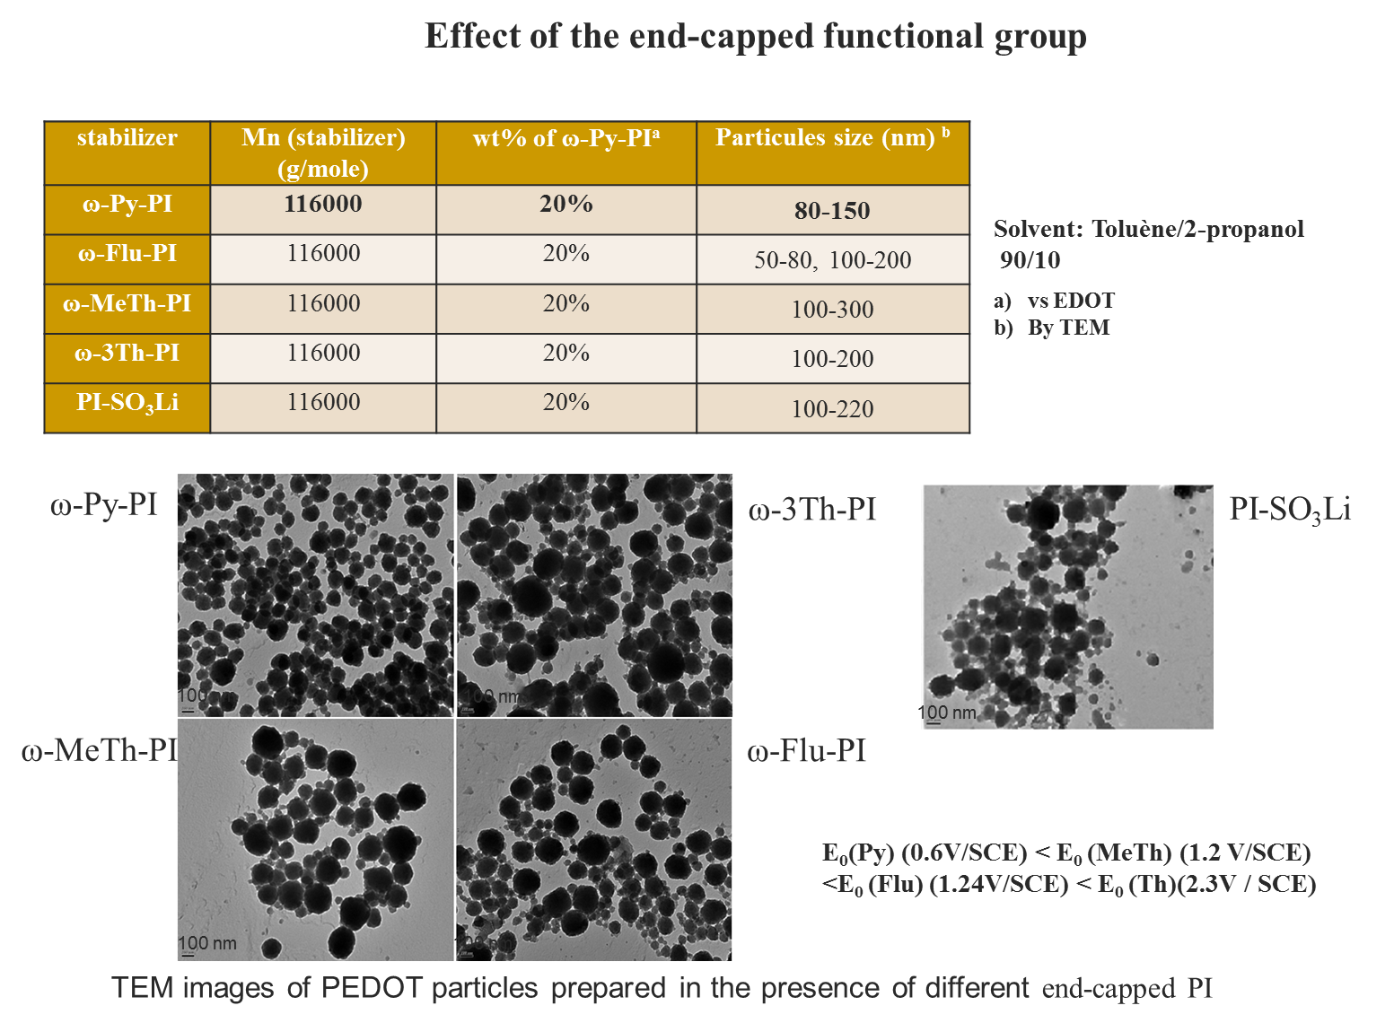

Slide 12
Preparation of polyaniline latex (PANI)

Slide 13
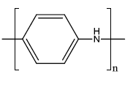
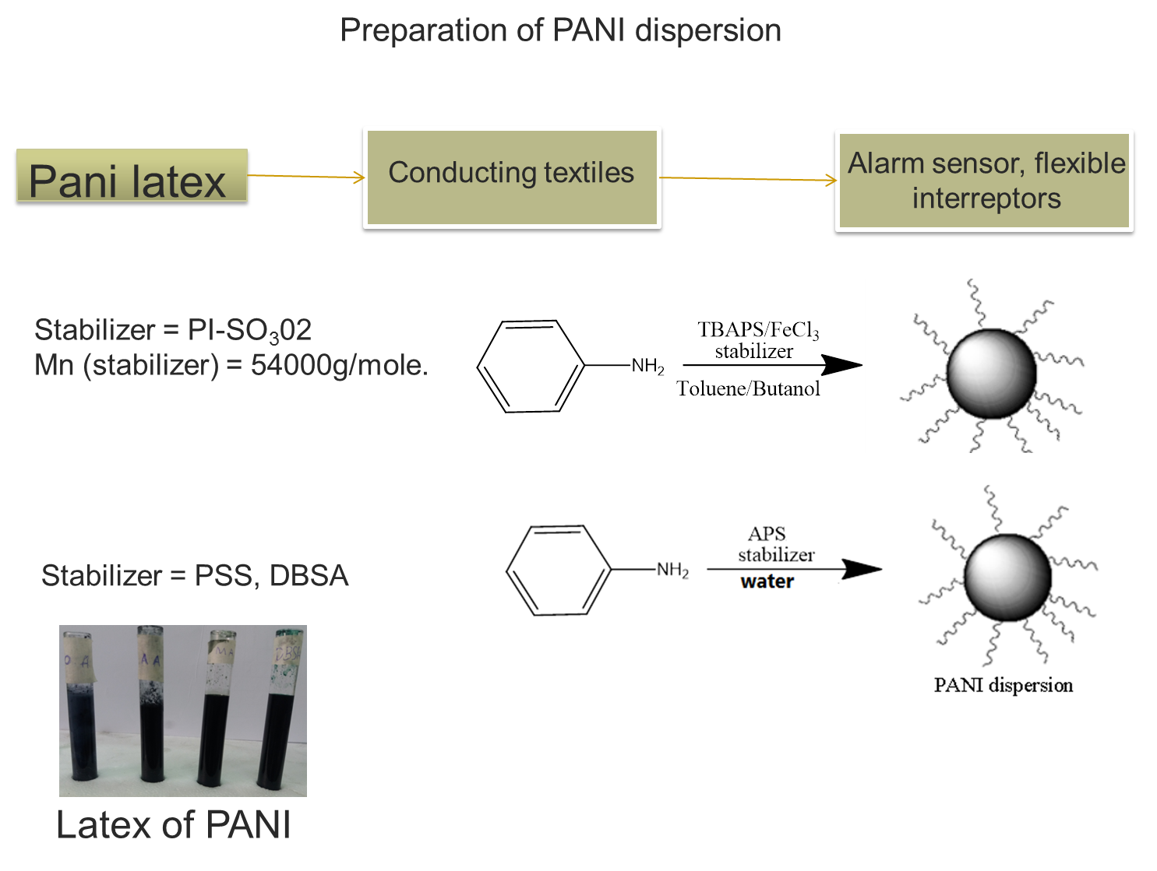
Alarm, sensors, flexible interrupters

Slide 14
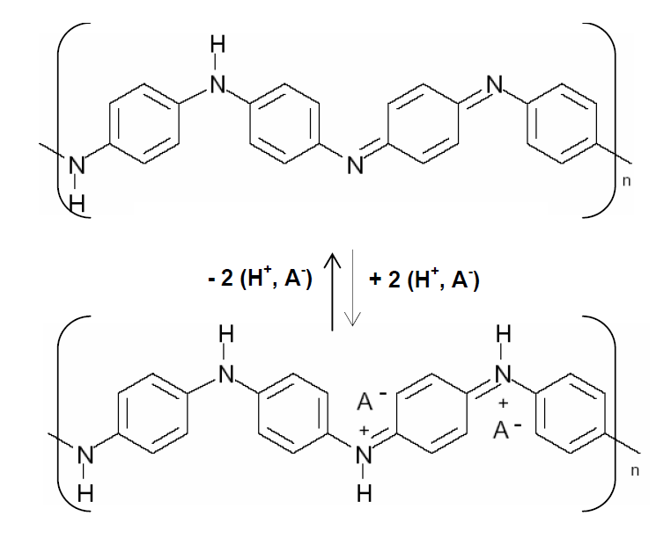
Preparation of PANI dispersion
Pani latex
Conducting textiles
Alarm sensor, flexible interrupters
Insulating structure (EB)
Conducting structure (ES)
Doping-Dedoping of PANI

Slide 15
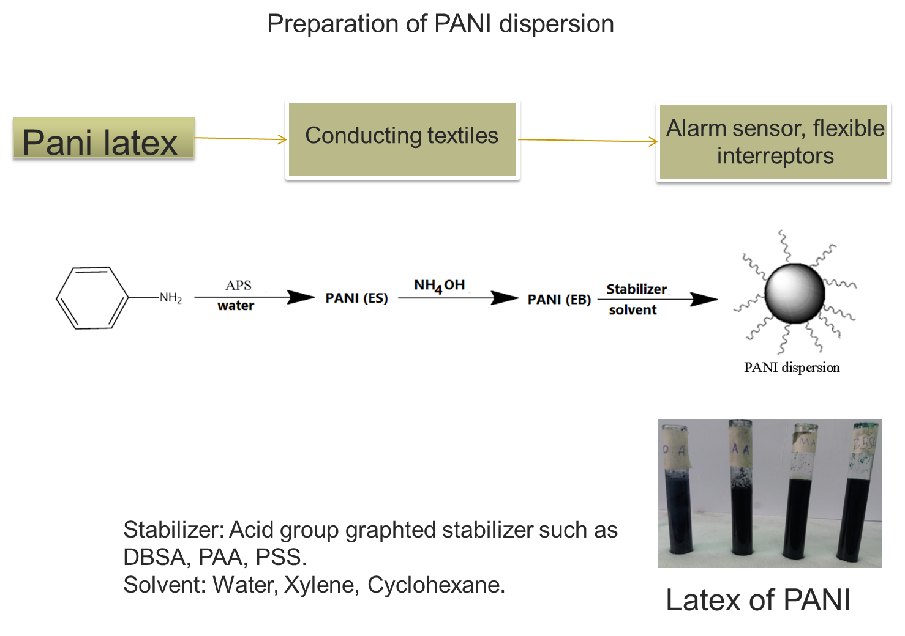
Alarm, sensors, flexible interrupters

Slide 16
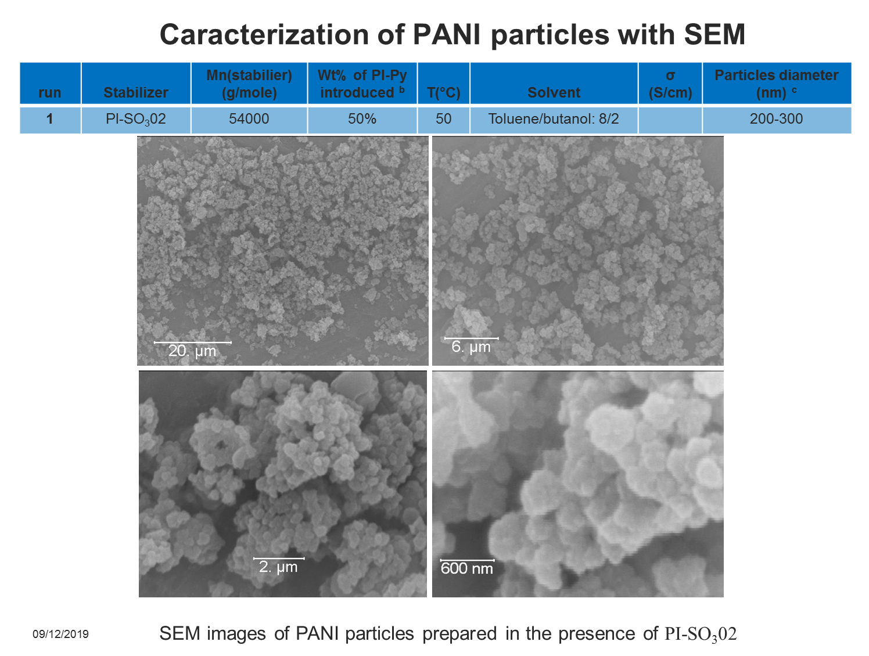

Slide 18
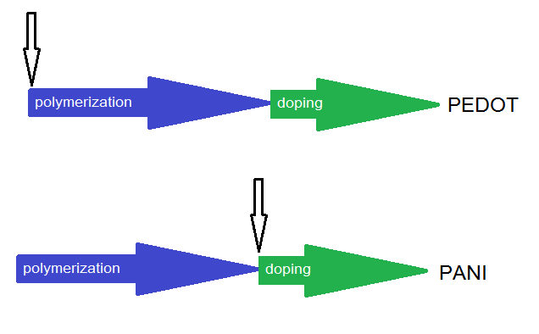
Comparison between PEDOT and PANI particle
PEDOT particles are smaller than PANI particles

Slide 19
Conclusion
Very small and well-defined PEDOT particles were obtained in the presence of various end capped PI used as a stabilizer in toluene.
Only 8 wt% of PI-Py (Mn=62000 g/mol) is needed to obtain very small PEDOT particles with a diameter of 80-100 nm.
Smaller particles were obtained with higher concentration or higher molecular weight of the stabilizer.
Efficiency of PI-Py is higher than the ones of PI-Fluo and PI-MeTh.
Sable particules of PANI in different solvents were obtained with two different technics.

Slide 20
Perspectives ➔ Applications
Alarm sensors
Textiles ➔ flexible electrode, flexible interrupters.
Electromagnetic shielding.
Solar cells

