Slide 1
Review of Nanostructured Materials in Aleppo University
By
Prof. Mohammad Anwar Batal

Slide 2
Stuff members:
Dr. Mohammad Anwar Batal
Dr. Ghassan Nashed
Dr. Fatima Srouji
Dr. Jamal Kassem Al Shaar
Dr.Mohammad Bashir Karman
Dr. Khalaf Abdullah (Electronics and Electric Engineering faculty)
Dr. Wafaa Haj Ismaeil
Dr. Marwa Bakour
Dr. Imad Aldeen Kalaf

Slide 3
Classifications:
2010-Now
1-Nanocomposites.
2-Nanostructured.
3-Quantum Dots(QDs).

Slide 4
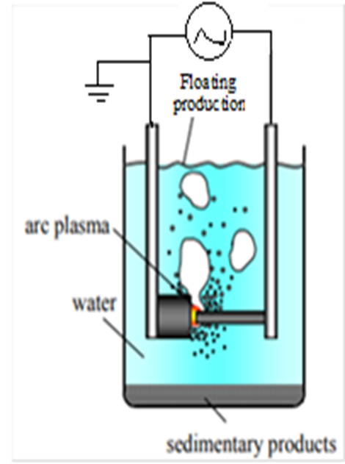
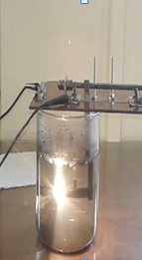
Now: our work focus on carbon allotropes
Carbon nanotube:
Carbon nanotube was produced by arc discharge in liquid environment and determined the proper method for purification of the result product. Our next steps are :
-development the facility production and reduce the amount of impurities by designing different configuration of plams arc reactor.
-depositing thin film of previous structure and studying its properties.

Slide 5
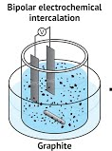
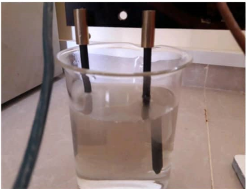
Now: our work focus on carbon allotropes
graphene:
N-Graphene has been prepared by liquid phase exfoliation in (NH₄OH) . the result product has treated by Urea to introduce nitrogen into graphene .IR-spectrum confirm the presence of C-N bond.
Polyaniline doped with Graphene: graphene has prepared by liquid phase exfoliation method by using H₂SO₄ solution to get rGO directly in the aim of expanding the application of conducting polymer especially in energy storage devices and gas sensors.

Slide 6
1-Nanocomposites:(polymer +Nanostructured materials)
-ZnO Nanostructured(50nm)with very low concentration of PolyVinylidene Fluoride(PVDF):
pyroelectrical materials used as IR detector in co-operation with electronic and electrical engineering faculty. (R Hamdan,K.Al Abdullah Journal of Electron Devices 24,2018).
-β-MnO₂+polyaniline(1:1):
β-MnO₂ nanostructure prepared by hydrothermal method .Because of high electrical conductivity of polyaniline and the electromagnetic properties of β-MnO₂ , theoretical simulation were done to determine optimal ratio of β-MnO₂+polyaniline to obtain the best shielding toward X- band microwave shield achieving shielding effectiveness SE: 99% ,currently experimental work is going on (Beslahlo,Batal-2019).
-PVDF+Graphene:
This was our lab early experiment with graphene. first of all, graphene oxide was papered by modified Hummer’s method .The resulting Graphene oxide powder was reduced to RGO by Hydrazine then GO or RGO was mixed with PolyVinylidene Fluoride(PVDF) to obtain nanostructured composites materials. Electrical properties of nanocomposites were studied and determine permeability which increase in presence of graphene so this composite can be used in different applications(pyroelectric material, pressure detectors).
(G Sabbag,M.A.Batal,M.B.Karman-2018).

Slide 7
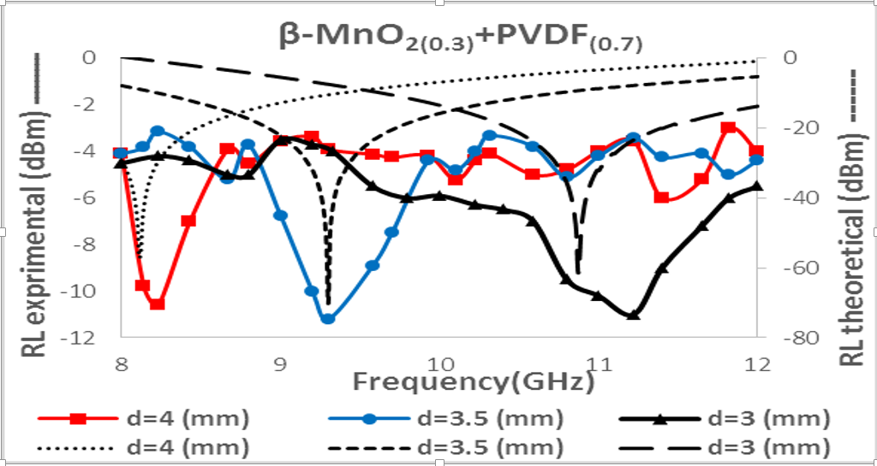
1-Nanocomposites:(polymer+ Nanostructured materials)
Β-MnO₂+ PVDF:
for microwave attenuation (absorption and scattering) with different thickness samples ,the return lose RL was measured achieving -79.81dB referring to high absorption energy.(Beslahlo,Karman-2015).
fig(1) Retunre lose as function of frequency X-band

Slide 8
2-Nanostructured materials:
Our early research was producing nanostructured materials to be used as gas ------- - SnO₂+CuO or SnO₂+Fe₂O₃ :
was synthesized by Sol-Gel method ,then it was deposited to form thin films by spin/deep coating. Then it was tested for H₂,H₂S detection, showing high sensitivity at 250°C.(Jneed, Nashed, Batal-2010)
-SnO2+TiO2: (1:1)
by Sol-Gel method the powder was prepared and pressed as pellet with sliver paste as electrode, this samples show enhancing in humidity detection rang (10-80)% (Nasser,Nashed,Batal-2010)
-SnO2 thin film:
as gas sensor in open system with satisfied result.(Jneed,Nashed,Bata-,2013)

Slide 9
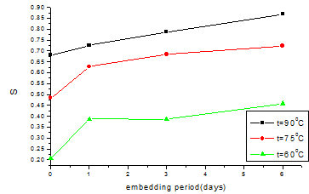
2-Nanostructured materials:
-ZnO+Polyaniline(PANI):
For volatile materials sensor, in two preparation methods :first one by ZnO pellets nanostructured(Z1,Z2,Z3,Z4) were embedded in polyaniline(PANI) dispersion for different periods of time (1day,3day,6day) to obtain the hybrid structure. The hybrid samples were faster to detect the target vapor(acetone ,ethanol) with approximately decrease in response time to a half in comparing with ZnO pure sample. The sensitivity increase by rising embedding period reaching to 86% for acetone at working temperature(t=90°C).
Fig(2):Sensitivity as a function of embedding period

Slide 10
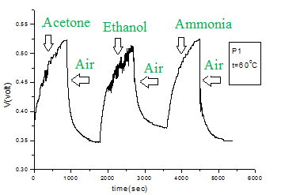
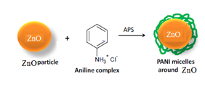
2-Nanostructured materials:
In the second way of papering, polyaniline –ZnO composite were synthesis at different %wt rate of aniline :ZnO(P1(1:1),P2(1:2),P3,(1:3)).The composite of polyaniline with ZnO was prepared by insitu chemical oxidation polymerization method,Fig(3)
Fig(3) schematic of polymerization
Fig(4) sensor respone of P1 at t=60°C
conclusion :the first one gives higher sensitivity and shorter response time toward ethanol and acetone vapors.(Haj Ismaeil, Zaroury,Allabdullah-2016).
Now we are working on this sensor to detect different gases such as :NO,NO₂,….

Slide 11
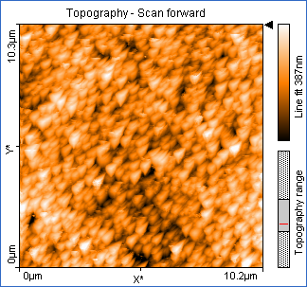
Further application of Nanostructured materials :
-TCO: transparent conductive layer:
(It has so many applications: solar cell, optoelectronics,…) it was prepared by thermal spray method to create defects in crystalline structure of Florid Tin Oxide SnO₂ (FTO(n)) with (10⁻³ Ω.cm) to be applied as transparent electrode in solar cell ,and it can be doped with CuO or Fe to obtain p-type semiconductor.
- pbS thin film as effective layer in solar cell:
(FTO(n)/ZnO or TiO2/CdS/PbS/FTO(p)oral) with power confident efficiency (PCE=23%).
-InSb nanowire as IR detector:
It is fabricated by using DC electro deposition in porous alumina: Self-ordering of the cell arrangement of the anodic porous alumina was prepared in oxalic acid solution at a constant potential of40V and at room temperature Alumina porous structure made by tow step anodization method . Au thin film was deposited by evaporation method on bottom side of template porous Alumina. InSb thin film have been fabricated by direct current electro deposition method in the porous anodic alumina.
Fig (5) AFM image of porous anodic alumina.

Slide 12
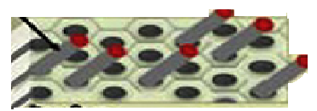
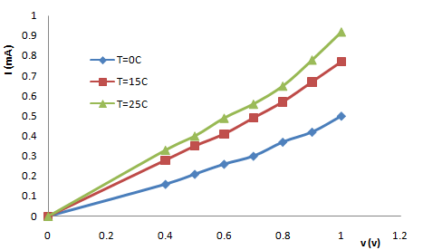
2-Nanostructured materials:
InSb nanowire growth on porous anodic alumina(honey comb). AFM image have-not been taken due to surface roughness of InSb nanowire Figure (6) shows the schematic of InSb nanowire:
Figure (6)
The electrical characterizations of the InSb/porous alumina were achieved through current–voltage measurements in the temperature.in the range of 273–298 K. as shown in fig() IR –response spectral
IR Absorption carried out in the rang wavelength (2.5-25µm) .fig(8)Shows the IR Absorption in function of wavelength ,it indicates the maximum absorption takes place in the rang wavelength (3-7µm) . but the energy band gab is (0.18ev) and it corresponds to wavelength (7.1µm).this wide IR absorption due to the nano structure of InSb and to stoichiometry.(Kilf,Nashed,Batal-2013).
Fig(7):I-V characterization of InSb/porous alumina

Slide 13
2-Nanostructured materials:
ZnO Nanoparticles as fertilizer:
Zinc oxide nanoparticles were manufactured by sol-gel method the resulting powder was dissolve in distilled water in different concentrations (10.25,50 ,75,100)ppm, The aim of this research is to manufacture nanoparticles fertilizers. and the study the impact of gradual concentrations on seed germination and growth Parameters of celery.
The seeds were treated with the following suspensions:
Zinc oxide nanoparticles in concentrations: (10, 25, 50, 75, 100 ppm) mg/L.
Bulk zinc oxide in concentrations: (10, 25, 50, 75, 100 ppm) mg/L.
ZnSO4 at a concentration of 5%.
Distilled water.

Slide 14
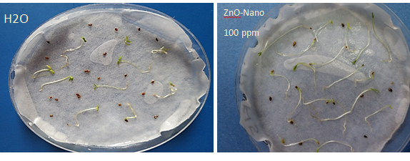
2-Nanostructured materials
ZnO Nanoparticles as fertilizer:
Conclusion:
Seeds treated with zinc oxide(Nano+Bulk) and zinc sulfate gave higher lengths compared to that treated by distilled water.it is noticed that Nanoparticles ZnO- (in all concentrations)is better than ZnO-bulk.table(2).
Nanoparticles provide more surface area for various metabolic reactions in the plant, which increases the rate of photosynthesis, and therefore reflected on the physical and morphological qualities like plant height and number of branches.
It is observed the superiority of seedling lengths that treated with zinc oxide nanoparticles in different concentrations on distilled water and zinc sulphate. This is due to its role in the formation of amino acid (tryptophan)which is important indole acid hormone production, which affects: The increase of cell division , enhances its activity, and thus the growth of cell consequently the growth of plant.(Ibrahim,AlKalaf-2019).
Treatments(in the best concentrations)
H₂O | ZnSO4 5% | ZnO-Np (100 ppm) | ZnO- bulk (100 ppm) | length (mm)
15 | 15 | 20 | 17 | Seedling
4 | 6 | 7 | 5 | Roots
Table(2):Growth parameters

Slide 15
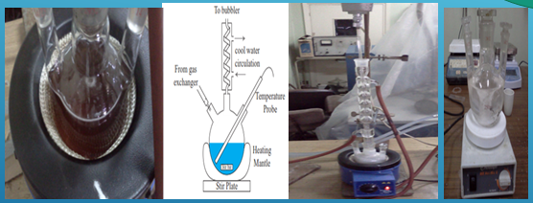
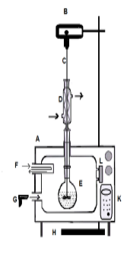
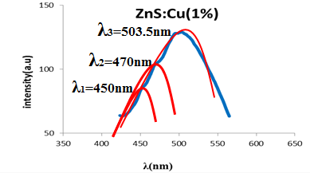
3-Quantum Dots(QDs):
ZnS(QDs):
prepared by using microwaves irradiation method in three different polymeric medium(PVA, (polyvinyl alcohol) PVPpolyvinylpyrrolidone, EG(Ethanol Glycol).
the QDs size were (2-4)nm which corresponding energy band gab (3.60-4.02 )eV. absorption peaks shifting toward red was noticed by the time due to increasing QDs size ,after doping with copper by the same method in PVA, the pL spectrum shows three convoluted peak (450,470,503)nm.
Fig(8) preparation method
fig(9):Photoluminescence peaks of ZnS:Cu QDs

Slide 16
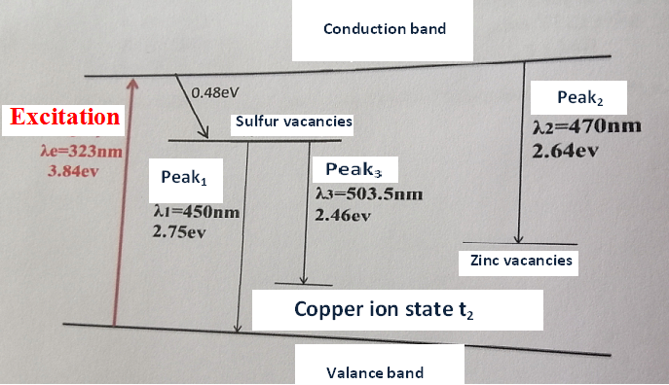
3-Quantum Dots(QDs):
ZnS(QDs):
the intensity of the peaks increase with the increase concentration of Cu. energy states schematic shows there are many(Zn ,S)vacancies, and Cu traps state of copper as shown in fig(10).(AlJader,Karman,Kayali-2015)
Fig (10) Energy states schematic

Slide 17
3-Quantum Dots(QDs):
-CdO(QDs):
CdO(QDs) Were prepared by in different mediums .absorption spectra peaks appears between (290-340)nm ,which shows that the emission spectra have red shift with size increase of the (QDs).(Murad,Srouji-2015)

Slide 18
Pharmacy faculty:
Some of Members Stuff
Dr. Wassim Abdelwahed
Dr. Adawia kitaz.
Dr. Rawaa Al-kayali
Dr. M.F. Chehna
Dr. G.DEOBERT
Dr. S. Trefi
Dr.Yasser Bitar

Slide 19
Some of pharmacy faculty contribution
1-Wassim ABDELWAHED, G.DEOBERT, H. FESSI. A pilot study of freeze drying of poly (epsilon-caprolactone) nanocapsules stabilized by poly (vinyl alcohol): formulation and process optimization. International journal of Pharmaceutics, (2006), 309 (1-2), 178-188.
2- Wassim ABDELWAHED, G.DEOBERT, H. FESSI. Investigation of nanocapsules stabilization by amorphous excipients during freeze-drying and storage. European Journal of Pharmaceutics and Biopharmaceutics. (2006), 63, 87-94
3- Wassim ABDELWAHED, G. DEGOBERT, H. FESSI. Freeze-drying of nanocapsules : impact of annealing on the drying process . International journal of Pharmaceutics. (2006), 324, 74–82 8-Wassim Abdelwahed. Lyophilization of solid lipid nanoparticles for brain targeting. International Journal of Pharmacy and Pharmaceutical sciences. Vol 7, Issue 10, 2015.
4- Wassim ABDELWAHED, G.DEOBERT, S. STAINMESSE, H. FESSI. Freeze-drying of nanoparticles: formulation, process and storage considerations .Advanced Drug Delivery Reviews, (2006), 58 1688-1713.

Slide 20
Some of pharmacy faculty contribution
5-A. DUBES, H. PARROT-LOPEZ, Wassim ABDELWAHED, G. DEGOBERT, H. FESSI, P. SHAHGALDIAN, A. W. COLEMAN, Scanning electron microscopy and atomic force microscopy imaging of solid lipid nanoparticles derived from amphiphiliccyclodextrins. European Journal of Pharmaceutics and Biopharmaceutics, 55 (2003) 279–282.
6-Wassim ABDELWAHED, G. DEGOBERT, A. DUBES, H. PARROT-LOPEZ, H. FESSI, Sulfated and non-sulfated amphiphilic-ß-cyclodextrins:Impact of their structural properties on the physicochemical properties of nanoparticles, International journal of Pharmaceutics, 351 (2008) 289–295.
7- N. Khayata, Wassim ABDELWAHED, M.F. Chehna, C. Charcosset, H. Fessi. Preparation of vitamin E loaded nanocapsules by the nanoprecipitation method: From laboratory scale to large scale using a membrane contactor. International journal of Pharmaceutics, 423(2012) 419–227.
8-Wassim Abdelwahed. Lyophilization of solid lipid nanoparticles for brain targeting. International Journal of Pharmacy and Pharmaceutical sciences. Vol 7, Issue 10, 2015.

Slide 21
Some of pharmacy faculty contribution
9- Alabsi a, Khoudary AC, Abdelwahed Wassim, Annal neurosci ,The Antidepressant Effect of L-Tyrosine-Loaded Nanoparticles: Behavioral Aspects.., 23 (2), 2016.
10-. Maaz , Wassim Abdelwahed , I.A. Tekko , S. Trefi,Influence of nanoprecipitation method parameters on nanoparticles loaded with gatifloxacin for ocular drug delivery A Int J Acad Sci Res 3 (1), 1-12
11- Razan Solayman Awad, Wassim Abdelwahed, Yaser Bitar,EVALUATING THE IMPACT OF PREPARATION CONDITIONS AND FORMULATION ON THE ACCELERATED STABILITY OF TRETINOIN LOADED LIPOSOMES PREPARED BY HEATING METHOD.International Journal of Pharmacy and Pharmaceutical Sciences, 171-178.
12-Andal Baaj, Yaser Bitar, Wassim Abdelwahed,Development and Control of Loperamide Loaded Solid Lipid and Polymeric Nanoparticles for Targeted Brain Drug Delivery.

Slide 22
Some of pharmacy faculty contribution
13-Mohamad Ali, Salah Alhaj Omar, Wassim Abdelwahed, Effect of Inner Capillary Diameter to Produce Electrospun Core- Shell Nanofiber Loaded with Gentamicin Sulfate,
14-Green synthesis of silver nanoparticles using some medicinal plants and studying their antibacterial and antibiofilm effects ,prof.Adawia kitaz, prof.Adawia kitaz, prof.Rawaa Al-kayali.

Slide 23
Thank you For Listening

