Slide 1
Role of nanotechnology in clinical pharmacogenetics & Histopathological to identification of Treated Thyroid Cancer Salem.O.Abdalla, Ph.D of clinical pharmacology Pharmacogenetics Wadi International University

Slide 2
AIMS OF THE STUDY Part one aims was to describe the incidence and the clinic pathological of thyroid cancer among patients diagnosed in histopathology department

Slide 3
Part tow aims investigate which specific cytochrome P450 enzymes are involved in the biotransformation of the analgesic-antipyretic common uses with some anti-cancer drugs

Slide 4
Introduction Thyroid cancer had marked variation in the prevalence all over the world it is more common in female compared with male in the third, fourth, and fifth decade of life3.Iin Iodine-rich areas higher frequency is papillary carcinoma of thyroid gland was noticed4. Reported incidence of both benign and malignant lesions in surgically treated thyroid swelling varies widely from one geographically area to other 5-6and the principle disease of thyroid gland are goiter "diffuse or nodular ", hypothyroidism, hyperthyroidism

Slide 5
The complex metabolism of metamizole has been the subject of many in-vivo studies (Levy et al., 1995). In the pharmacokinetics of metamizole, the specific CYP catalyzing the formation of the primary metabolic step to the active metabolite 4-aminoantipyrine (4-AA) is still not known.

Slide 6
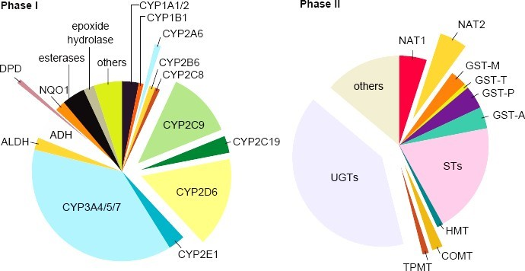
Participation of specific human liver cytochrome P450 enzymes (left side) and phase-II-enzymes (right side) in drug metabolism.

Slide 7
MATERIALS AND METHODS
Retrospective study of 210 cases diagnosed of thyroid cancer in Histopathology department at Tripoli Medical Center over 10 years period from January 2002 till December 2012. Demographic characteristics (age and gender, clinical information).

Slide 8
The produced metabolites were identified and quantified using HPLC analysis. Enzyme kinetic data analysis was finally used to determine enzyme kinetic parameters by nanotechnology spectrophotometer.

Slide 9
THE RESULTS

Slide 10
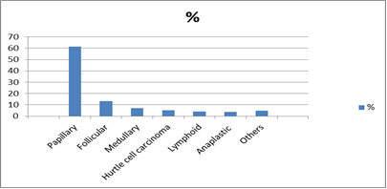
THE RESULTS

Slide 11
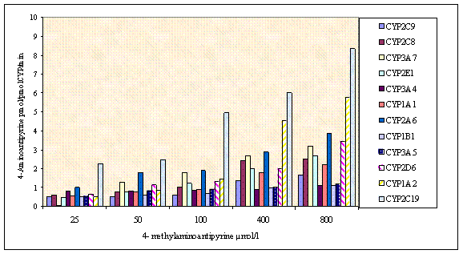
Inculpation of Metamizole with CYP 450

Slide 12
Calculated intrinsic clearance of 4-dimethylaminoantipyrine by specific human cytochrome P450 enzymes after incubation of 4-DMAA with microsomes expressing human recombinant P450 isozymes (600 nmo/µl) for 20 min. The formation of 4-methylaminantipyrine (MAA) was monitored by HPLC analysis with UV detection. Results are given as means of duplicate incubations.

Slide 13
CONCLUSION

Slide 14
Thyroid cancer is more common in females compared to males. The most common pattern for the thyroid cancer was for papillary carcinoma with an incidence of 61.43%. Finally, we need to have multicenter studies for thyroid malignancy to investigate the national pattern and trend of thyroid
CONCLUSION

Slide 15
Altogether, these findings suggest that CYP2C19 and CYP2D6 are medically important enzymes responsible for the metabolism of therapeutic agents on the analgesic-antipyretic drugs, metamizole and Aminopyrine and the role of the genetic polymorphisms in the genes coding for these enzymes for adverse effects should be further studied.

Slide 16
Thanks for listening
Salem Abdalla

